Slide 1
ISA & Addressing mode
Computer Architecture, by Thavorac

Slide 2
What is instructioin set architecture?

Slide 3
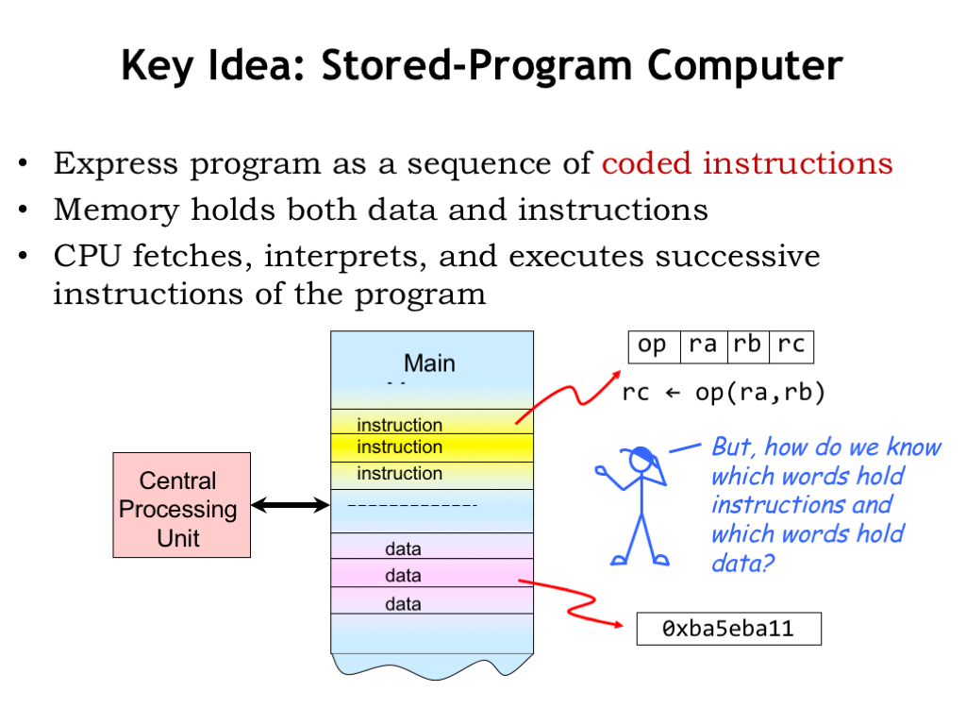

Slide 4
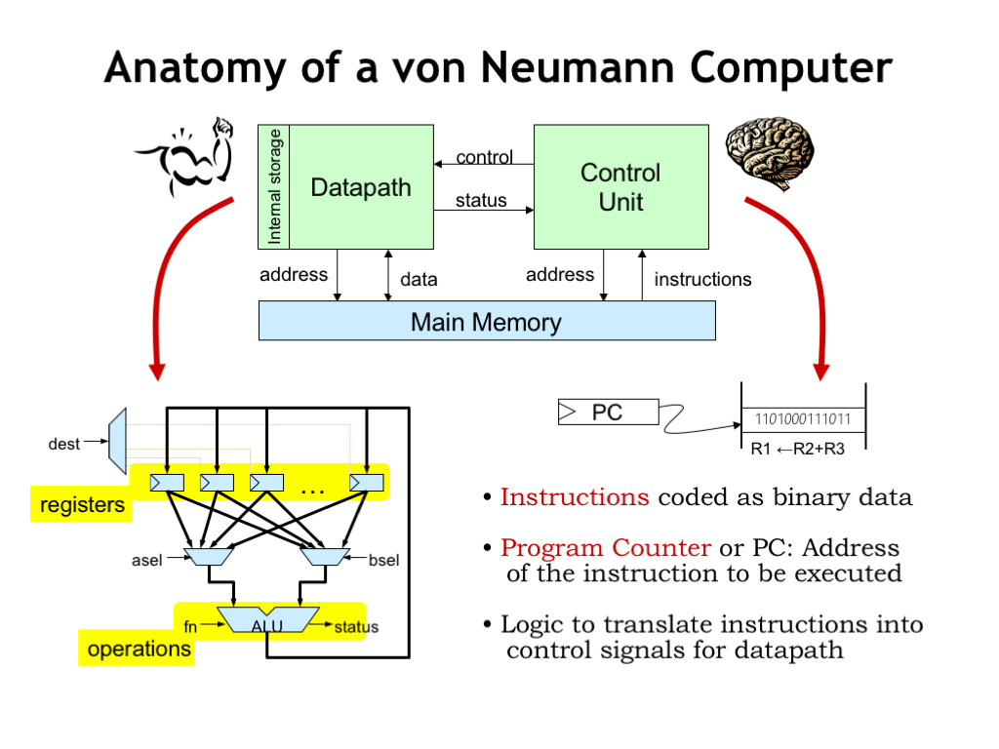

Slide 5
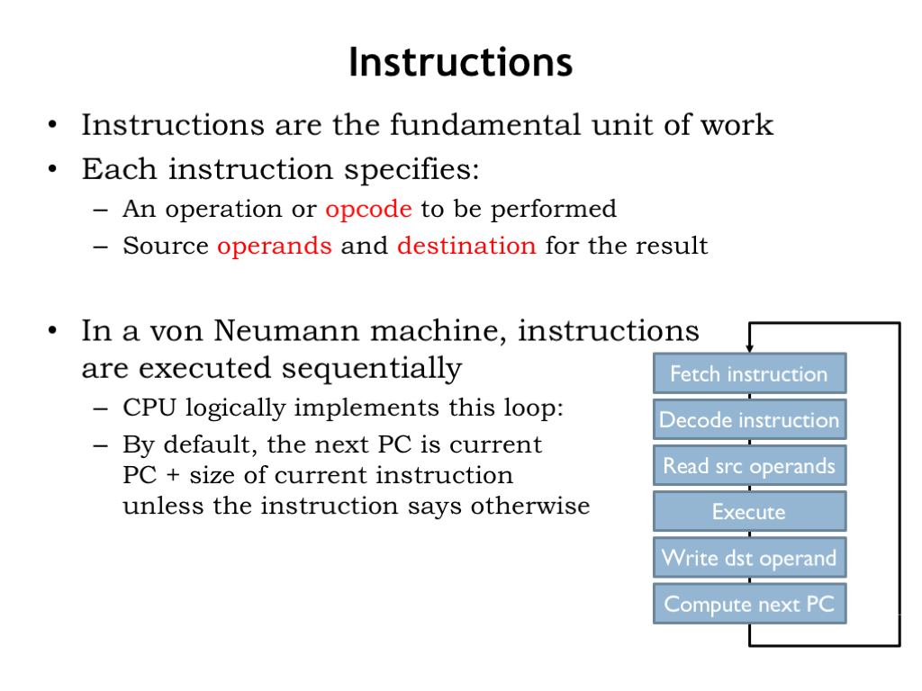

Slide 6
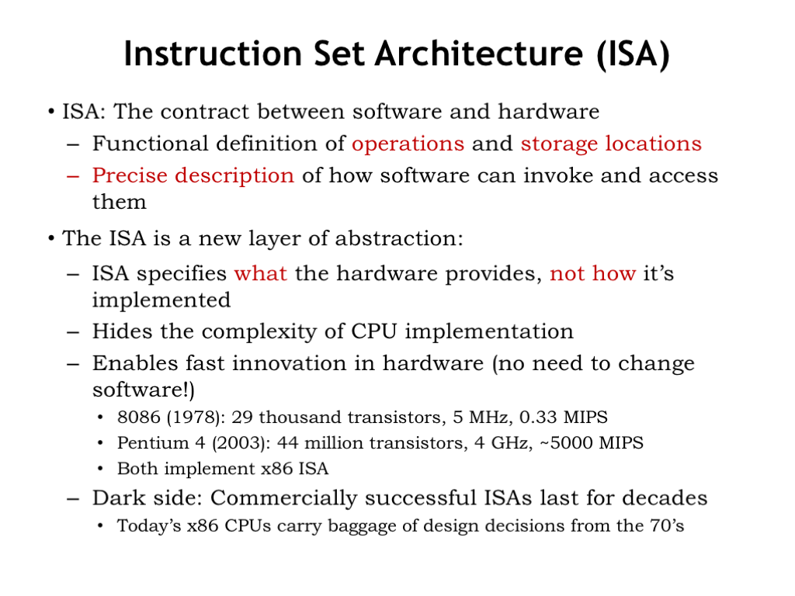

Slide 7
How ISA is designed?

Slide 8
Instructions are differentiated by the following features:
Operand storage in the CPU (data can be stored in a stack structure or in registers)
Number of explicit operands per instruction (zero, one, two, and three being the most common)
Operand location (instructions can be classified as register-to-register, register- to-memory or memory-to-memory, which simply refer to the combinations of operands allowed per instruction)
Operations (including not only types of operations but also which instructions can access memory and which cannot)
Type and size of operands (operands can be addresses, numbers, or even characters)

Slide 9
ISAs are measured by different factors:
Amount of space program a program require
the complexity of the instruction set, in terms of the amount of decoding necessary to execute an instruction, and the complexity of the tasks performed by the instructions
the length of the instructions
the total number of instructions

Slide 10
Things to con- sider when designing an instruction set include
Short instructions are typically better
Instructions of a fixed length are easier to decode but waste space
Memory organization affects instruction format
A fixed length instruction does not necessarily imply a fixed number of operands
There are many different types of addressing modes
If words consist of multiple bytes, in what order should these bytes be stored on a byte-addressable machine?
How many registers should the architecture contain and how should these registers be organized? How should operands be stored in the CPU?

Slide 11
Addressing modes

Slide 12
The operation field of an instruction specifies the operation to be performed. This operation will be executed on some data which is stored in computer registers or the main memory. The way any operand is selected during the program execution is dependent on the addressing mode of the instruction
Why do you need addressing modes?
To give the programming versatility to the user.
To reduce the number of bits in addressing field of instruction.

Slide 13
Addressing modes:
Immediate Addressing
Direct Addressing
Indirect Addressing
Register Direct Addressing
Register Indirect Addressing
Displacement Addressing
Relative Addressing

Slide 14
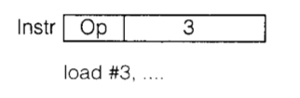
Immediate Addressing Mode
The operand is specified in the instruction itself. An immediate mode instruction has an operand field rather than the address field.
Load 3 => 3 is the operand here

Slide 15
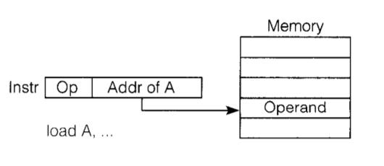
Direct Addressing Mode
In this mode, effective address of operand is present in instruction itself.
Single memory reference to access data.
No additional calculations to find the effective address of the operand.

Slide 16
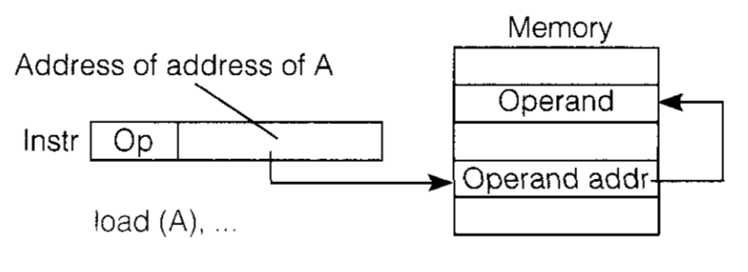
Indirect Addressing Mode
In this, the address field of instruction gives the address where the effective address is stored in memory. This slows down the execution, as this includes multiple memory lookups to find the operand.

Slide 17
Register Direct Addressing Mode
In this mode the operand is stored in the register and this register is present in CPU. The instruction has the address of the Register where the operand is stored.

Slide 18
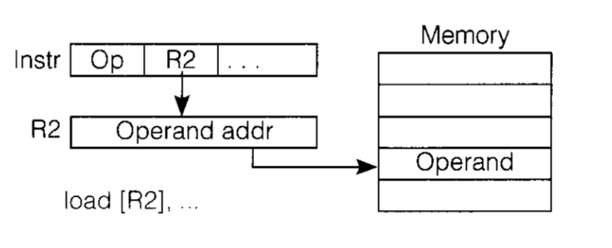
Register Indirect Addressing Mode
In this mode, the instruction specifies the register whose contents give us the address of operand which is in memory. Thus, the register contains the address of operand rather than the operand itself.

Slide 19
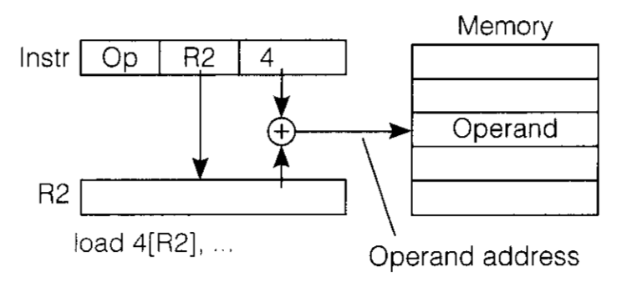
Displacement Addressing Mode
In this the contents of the indexed register is added to the Address part of the instruction, to obtain the effective address of operand.

Slide 20
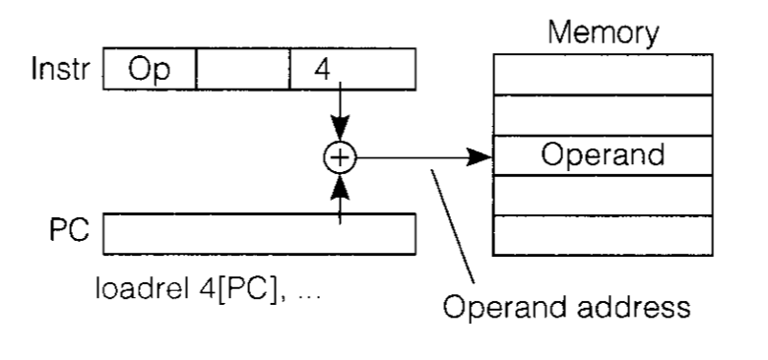
Relative Addressing Mode
It is a version of Displacement addressing mode.
In this the contents of PC(Program Counter) is added to address part of instruction to obtain the effective address.

